Slide 1
WebAppraisal: Sprint 2
Josh Basar, Alec Breslow, Kimberly Nguyen, Matthew Peace, Brent Schapman, Brian Shuryan

Slide 2
Introduction
Appraisal Data Collection is performed by a real estate appraiser who estimates the value of a home during the selling or buying process. Our web application with mobile platform support will enable appraisers to quickly and efficiently appraise homes in the field and allows customers to view appraisals.
Today we will be outlining our progress made in Sprint 2, risks and challenges encountered, and goals for the upcoming sprint.
Notes:
Transcript: Appraisal Data collection is a task performed by appraisers during the home buying process. A real estate appraisal is an expert estimation on a home, so sellers and buyers can understand the value of the home they are interested in selling/buying. They look at many factors and variables to make this estimation including location, condition, property age, property updates, etc. Our goal is to create a web application that can take all these various inputs and output an estimated value for that home. Today we are going to talk about our plans to complete this project, our goals, and software we will be using to achieve them.

Slide 3
Pre-Sprint Goals
Finalize and set up development environment for all team members
Design and initialize database
Implement account creation and management
Write all applicable unit and end-to-end tests for customer workflows
UI designs for Sprint 2 work

Slide 4
Sprint Milestones
This sprint, we satisfied the following user requirements:
As an appraiser I am able to a new account or securely log into an existing account
As a customer requesting an appraisal I am able to a new account or securely log into an existing account
While we were able to partially these requirements this sprint, but there is still work to be done.

Slide 5
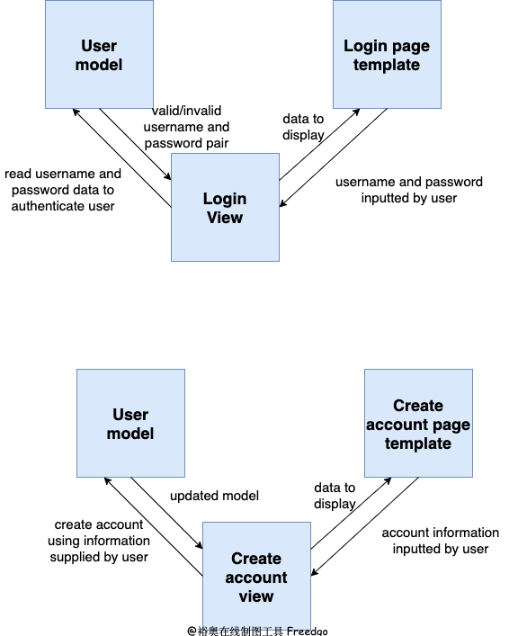
Login Architecture

Slide 6
Account Creation Architecture

Slide 7
Work to be done
Due to challenges faced throughout the sprint, we were not able to integrate login functionalities
Automated tests have not been implemented
The UI for the account creation page is unfinished
Other functions such as password resets, account deletion, and account updates were not implemented

Slide 8
Challenges from this Sprint
Unclear roles and task allocation
Impact: Redundant work being done
Action: Focusing more on sprint planning and make use of Trello board even more
Lack of knowledge among team members with technologies being used (Django, git)
Impact: Unexpected issues setting up project resulted in some goals (Login, QA testing) being forfeited this sprint
Action: Start to timebox issues and ask for help from other team members when needed

Slide 9
Demo!

Slide 10
Next Sprint Objectives
Integrate login functionality
Finish UI for account creation page
Create QA tests for user authentication system
Create home page with mock house data dashboard
Add mock UI layout
Adding Wireframes

Slide 11
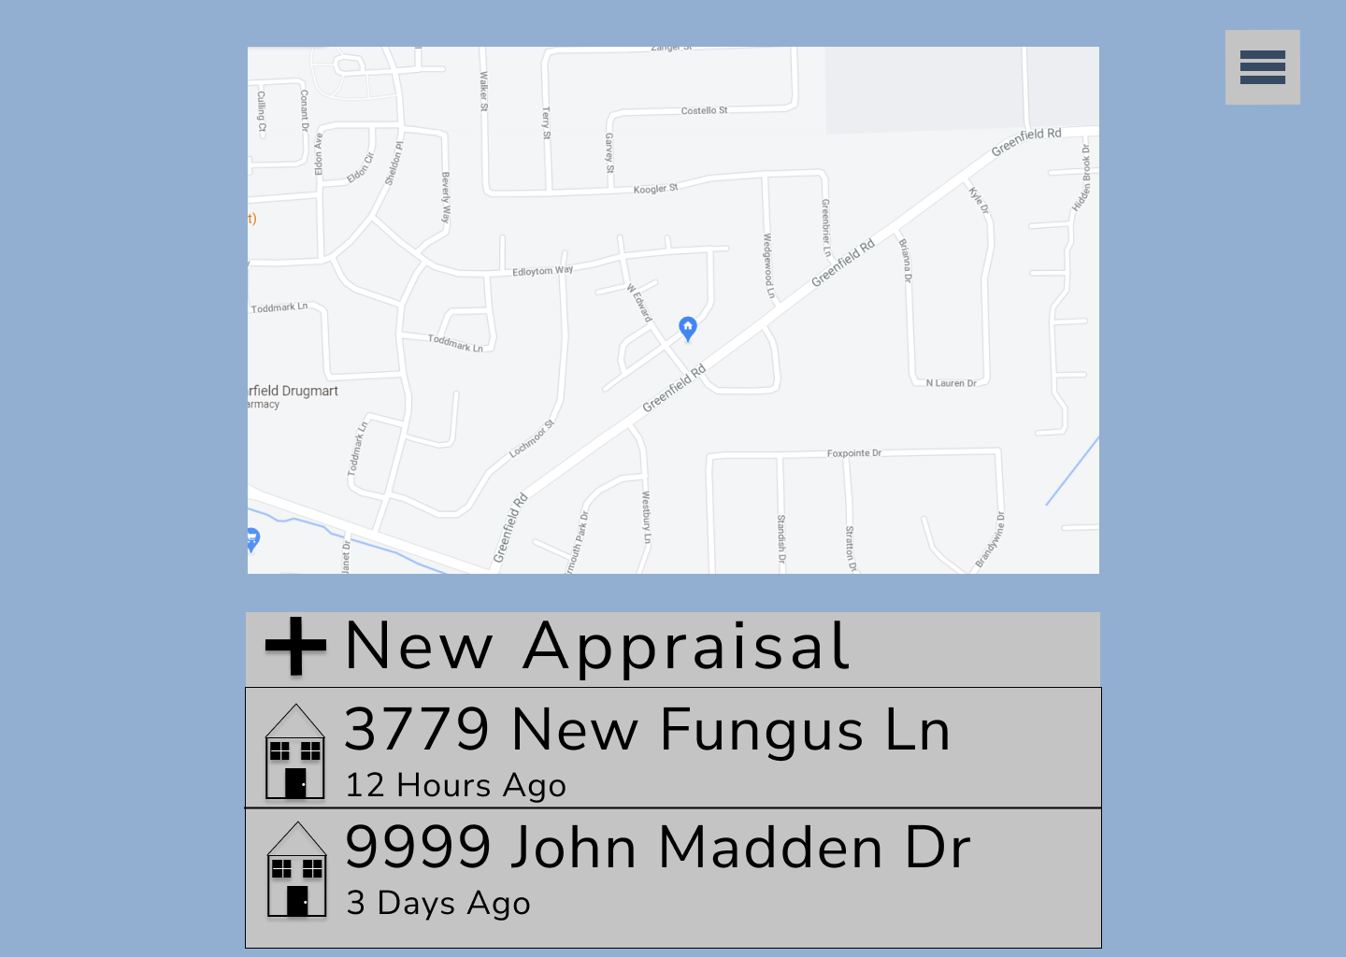
UI Design for Next Sprint

